Slide 1
Introduction to Travel Demand Modeling
Amar Pillai
April 11, 2022

Slide 2
Tools for Transportation Planning
Non-modeled:
Trend Line Analysis
Modeled:
Travel Demand Model

Slide 3
What is a model?
A representation of a real object or system that accounts for its relevant properties.
Real World “Object”
Model

Slide 4
What is a travel demand model?
A systematic process for translating land use and transportation supply into projections of travel demand
Land-Use
Transportation Network

Slide 5
What is a travel demand model?
Trip Generation
How many trips will be made?
Trip Distribution
Where do trips go to?
Mode Choice
How will they get there? Automobile, transit, bicycle, or walking
Assignment
What routes are taken?
5

Slide 6
Few Key Concepts
What are these?
Traffic Analysis Zone (TAZ)
Centroid
Centroid Connector

Slide 7
Few Key Concepts-TAZ
Schematic Representation of TAZ
Model Boundary

Slide 8
Few Key Concepts-TAZ
Schematic Representation of TAZ
5
1
3
7
6
8
2
4
Model Boundary
TAZ
x
TAZ No.

Slide 9
Few Key Concepts-TAZ
TAZ-A common sense subdivision of the study area
Typically created along census boundaries (census block, group & tract)
Contains homogenous land-use
Why TAZs? To simplify the modeling process made.

Slide 10
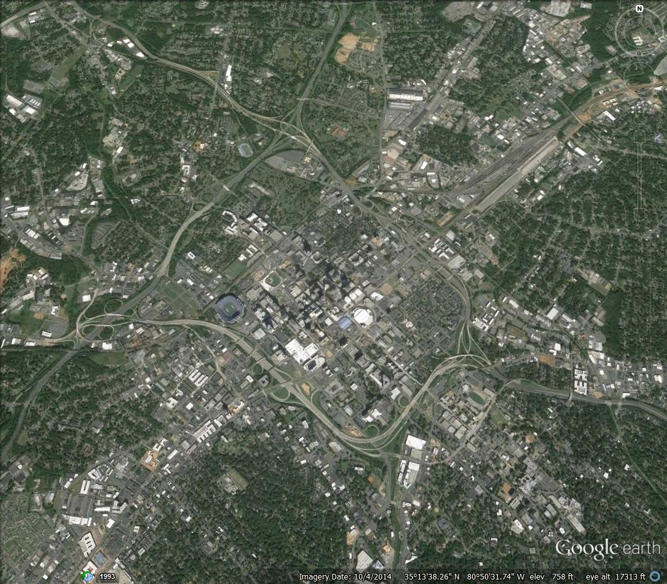
Few Key Concepts-TAZ

Slide 11
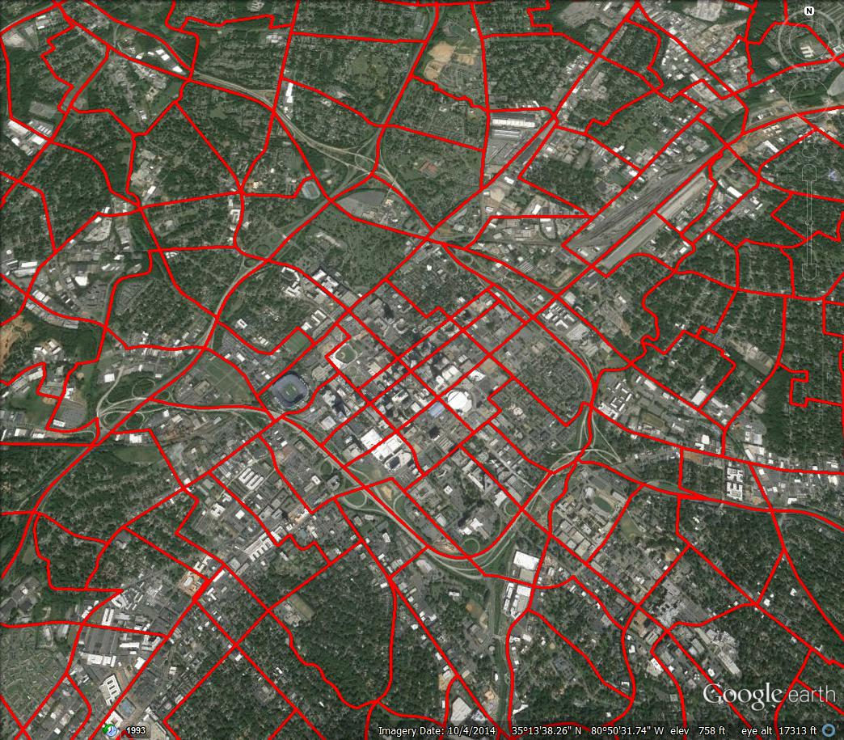
Few Key Concepts-TAZ

Slide 12
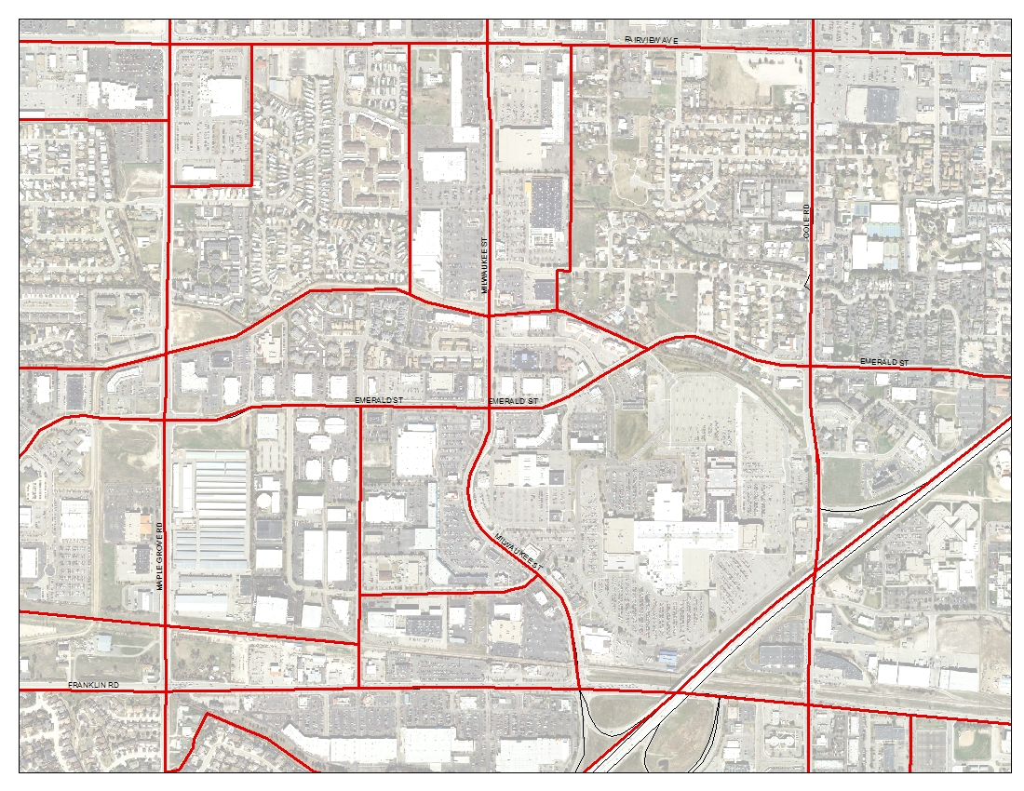
TAZ No 526
Household Data
Households= 267
People =633
Vehicles =533
Employment Data
Retail=58
Office=202
Industrial=0
TAZ No 526
Household Data
Households= 267
People =633
Vehicles =533
Employment Data
Retail=58
Office=202
Industrial=0
TAZ No 494
Household Data
Households=4
People =9
Vehicles=8
Employment Data
Retail=2991
Office=218
Industrial=5
TAZ No 494
Household Data
Households=4
People =9
Vehicles=8
Employment Data
Retail=2991
Office=218
Industrial=5
12
12

Slide 13
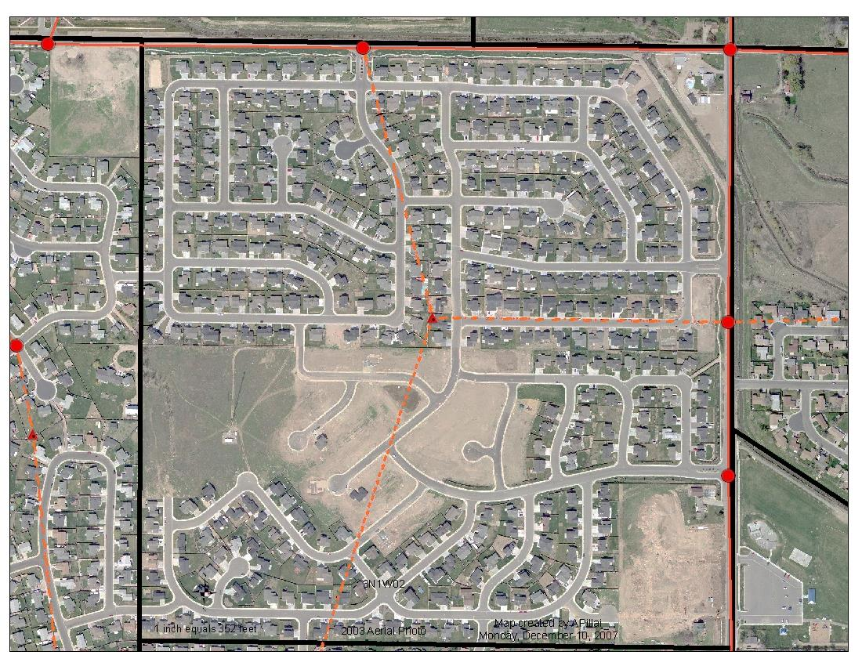
Few Key Concepts-Centroid & Connector
TAZ
Centroid
Connectors

Slide 14
Model Structure
Input
Trip Generation
Trip Distribution
4-Step Model
Mode Choice
Assignment
Final Output
14

Slide 15
Input Data-Model Foundation
Input Data is critical!!!
Why?
Garbage in, garbage out!

Slide 16
Input Data
Socio-Economic data/Demographics
Population
Households
Jobs (Office, Retail, Highway Retail, Service, Industrial)
School (K-12, Western Carolina University)
Transportation Network

Slide 17
Input Data-Demographics
Socio-Economic data/Demographics
Population
Households
Employment
School enrollment
Vehicle ownership
Compiled using
Census data
Local comprehensive plans
Employment data from private vendors (infoUSA) and reviewed by local staff and CTP Committee
School data
Aggregated at the TAZ level

Slide 18
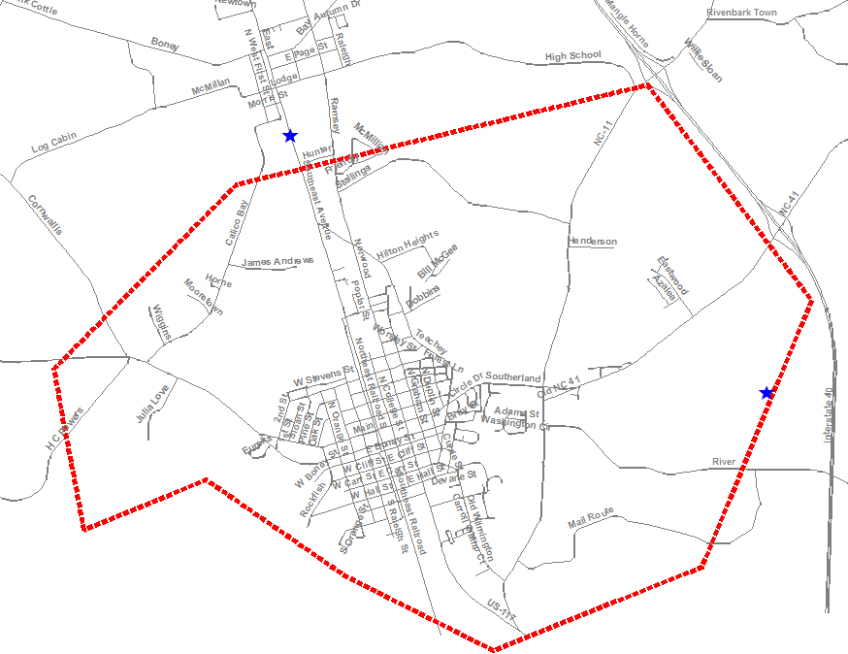
Input Data- Transportation Network
Model Boundary

Slide 19
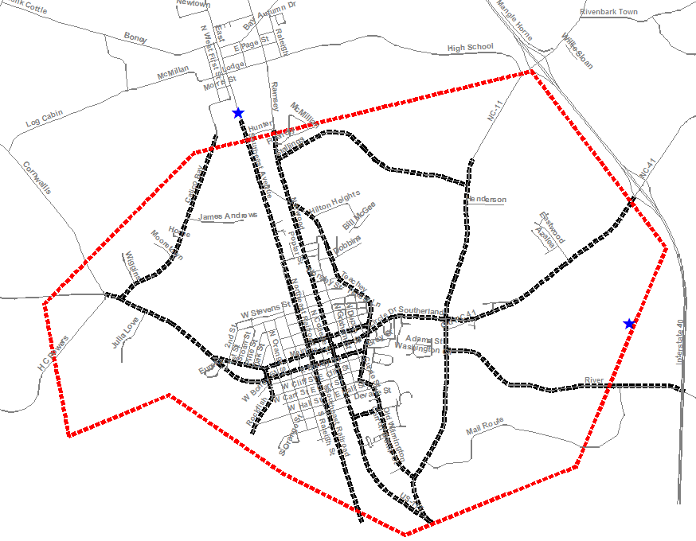
Input Data- Transportation Network
Model Boundary
Model Network

Slide 20
Model Structure
Input
Trip Generation
Trip Distribution
4-Step Model
Mode Choice
Assignment
Final Output
20

Slide 21
Trip Generation
How many trips are generated?
Work Trips
Shopping trips
Other Trips & More….
School Trips

Slide 22
Trip Generation
How many trips are generated?
Determines how many Productions or Attractions are in each TAZ in a typical day
Characterized by trip purpose. E.g. Home-based-work, Home-based-school, Home-based-other etc.

Slide 23
Trip Distribution
Where do the trips go to (or come from)?
Determines how many trips begin or end in each TAZ in a typical day
Trip distribution is done through:
Gravity Model

Slide 24
Trip Distribution
Gravity Model
(Based on Newton’s Law of Gravity)
Distributes trips based on “size” and “distance” to other zones
Size: Land use
Distance: Any “cost factor”. e.g. distance, travel time, cost ($)

Slide 25
Mode Choice
How will they get there?
Mode

Slide 26
Mode Choice
How will they get there?
Small Area Models do not have an explicit mode choice model
Non-vehicular trips are removed before trip assignment
other zones
Non-vehicular modes typically comprise about 5% of the total trips

Slide 27
Trip Assignment
Route 1
Work
Route 2
Home
Route 3

Slide 28
Trip Assignment: “The Circle of Traffic”
Freeway (65 mph) : Capacity 2000
Homes
Jobs
3000 Trips
Arterial (45 mph) : Capacity 1000

Slide 29
Trip Assignment: “The Circle of Traffic”
Freeway (65 mph) : Capacity 2000
3000 Trips
Homes
Jobs
3000 Trips
Arterial (45 mph) : Capacity 1000

Slide 30
Trip Assignment: “The Circle of Traffic”
Freeway (65 mph) : Capacity 2000
1750 Trips
Homes
Jobs
3000 Trips
1250 Trips
Arterial (45 mph) : Capacity 1000

Slide 31
Trip Assignment: “The Circle of Traffic”
Freeway (65 mph) : Capacity 2000
2000 Trips
Homes
Jobs
3000 Trips
1000 Trips
Arterial (45 mph) : Capacity 1000

Slide 32
Outputs
Volumes
Congested Speed
Volume-capacity ratio
Travel times

Slide 33
Evaluating Outputs
Operational Conditions 2050 (Model)
Volume: 15, 000
Volume/Capacity Ratio: 1.25
Congested Speed: 25 mph
John Doe Boulevard
Roadway Characteristics
Major Principal Arterial
Capacity: 12, 000
Speed: 50 mph
Operational Conditions 2022
Volume: 11, 000
Volume/Capacity Ratio: 0.85
Congested Speed: 35 mph

Slide 34
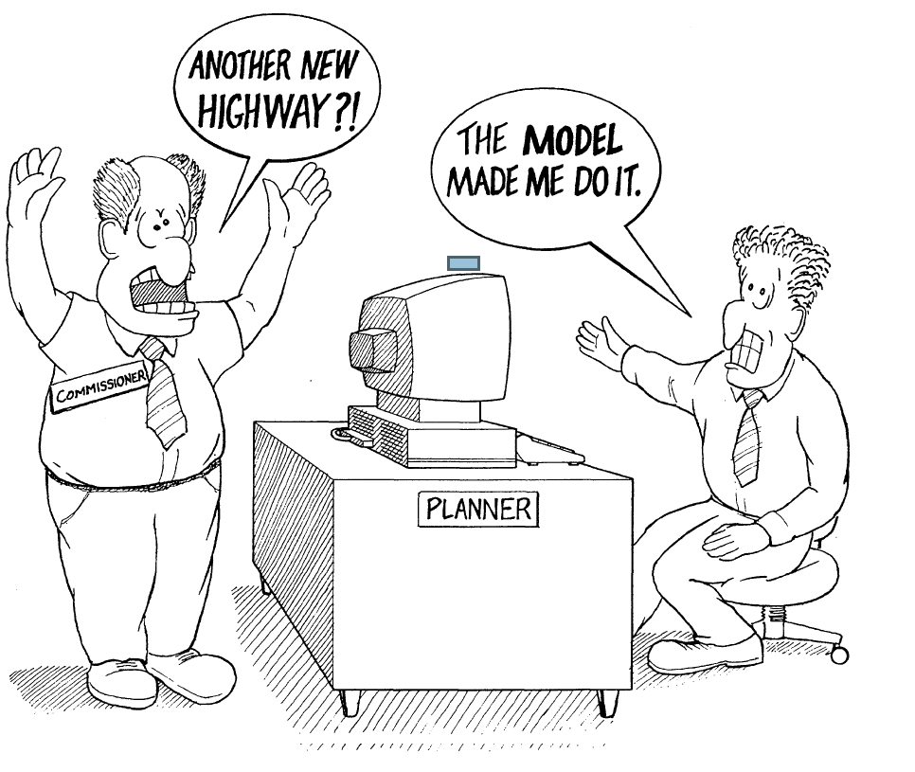
Disclaimer: Resemblance of any events in this caricature to actual incidents is obvious!

Slide 35
Travel Demand Modeling-ASSUMPTIONS
Demographics- Can be forecasted correctly?
External Factors- They don’t affect us?
Future Conditions: Can be predicted?
Human Beings-We behave rationally?

Slide 36
How can local planners assist with the development of a Travel Demand Model (TDM)?
Input on establishing the model boundary
Input on roads to study (staff and CTP Steering Committee)
Driving the study roads with TPD staff
Verifying employment data (overall and by TAZ – Employers may trust a local call versus a call from “Raleigh”)
Growing and verifying population (overall and by TAZ – building permits are helpful)
An extra set of eyes to check the base year data (road attributes, population etc.)
Assistance with future year population and employment projections (staff and CTP Steering Committee)

Slide 38
Contact Us
Dominique Boyd 919-707-0932 dlboyd1@ncdot.gov
J. Andy Bailey 919-707-0991 jabailey@ncdot.gov
Roger Castillo, PE 919-707-0934 ricastillo@ncdot.gov
Amar Pillai 919-707-0972
apillai@ncdot.gov

